Slide 1
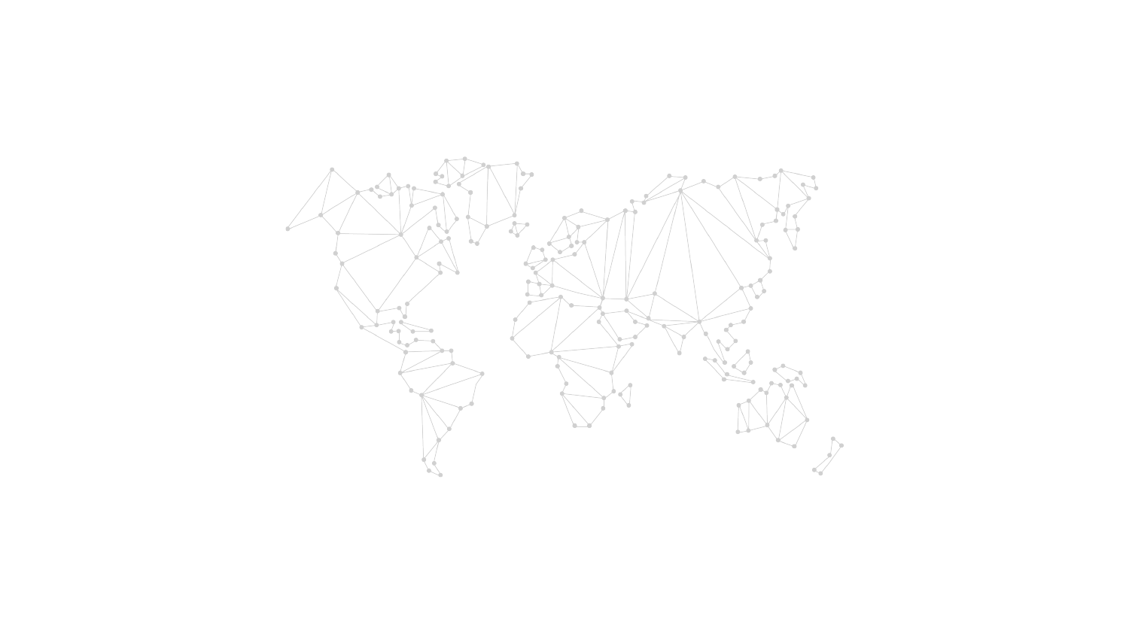
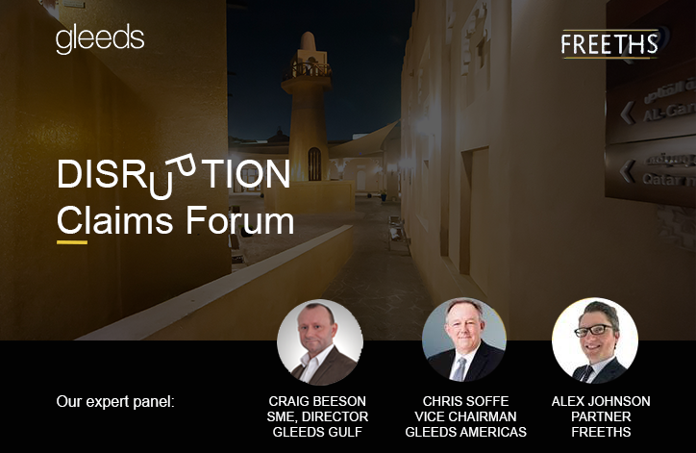

Slide 2
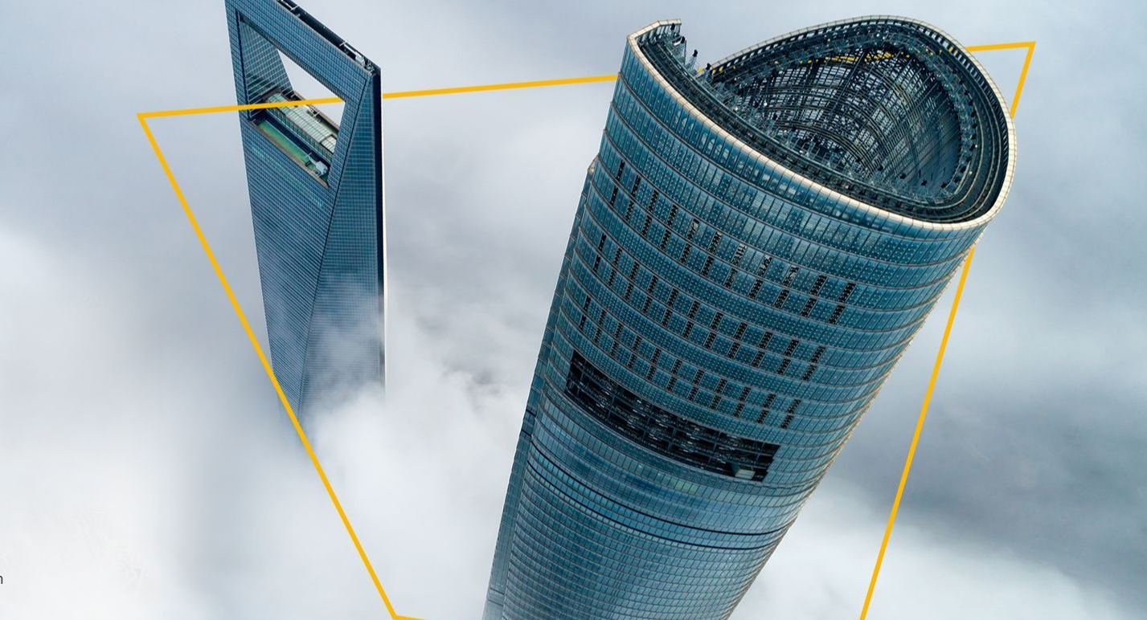
Disruption Claims in Qatar webinar
243 attendees
35 countries
30 live questions

Slide 3

What’s on the agenda?
?
?
?
?
30min + 30min
?
?
Notes:
Our goal is to strengthen existing and build new collaborative strategic alliances.
We’re counting on your support:
with introducing us to potential leads and/or identify DA opportunities
to reach out to us when you are facing issues with your current DA projects
if you want to get involved

Slide 4
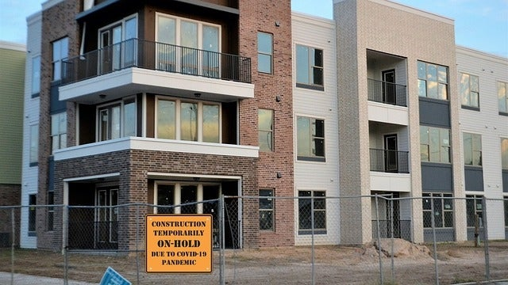


Slide 5



Construction Disputes A to Z
One stop shop
We are offering access to technical and legal experts with over 20 years’ combined experience in advising clients and considering their specific contract and project needs. We believe disputes should be avoided wherever possible, but we have expertise in resolving them when they occur.
advisory@gleeds.qa
ARBITRATION AND
LITIGATION SUPPORT
COST
/QUANTUM ANALYSIS
EXPERT WITNESS
CONTRACT ADVISORY SERVICES
CONTRACT/RISK ANALYSIS /
CONTRACT HEALTH-CHECKS
CLAIMS ADVICE
MEDIATION AND ALTERNATIVE DISPUTE RESOLUTION
FORMAL DISPUTE RESOLUTION

Slide 6
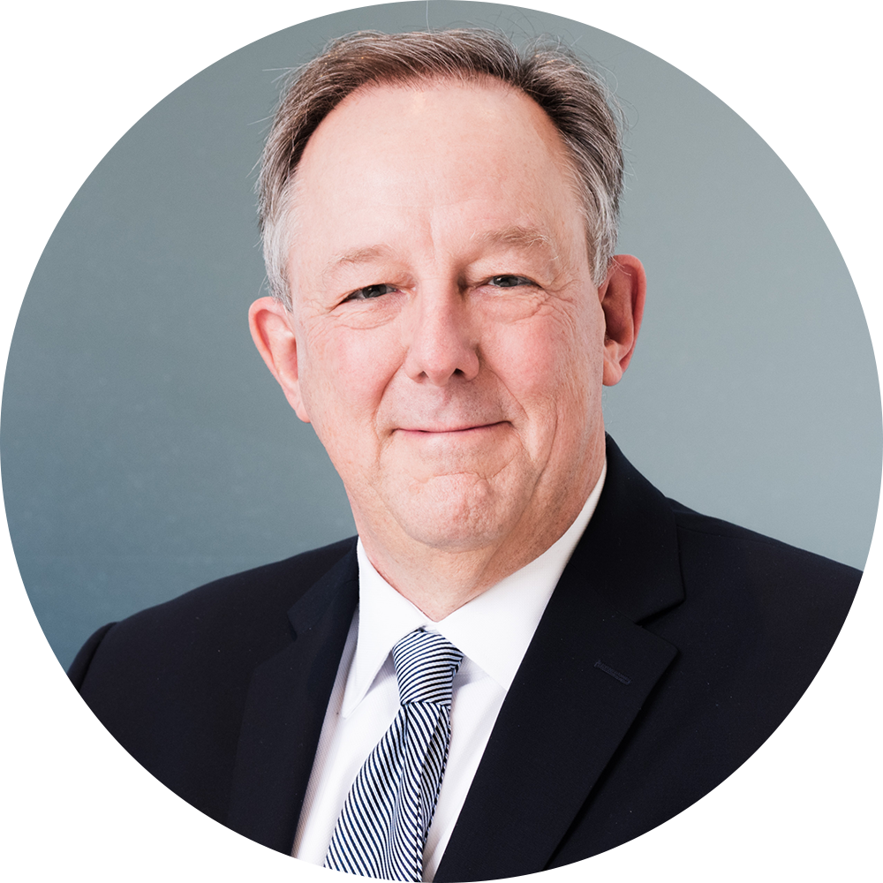
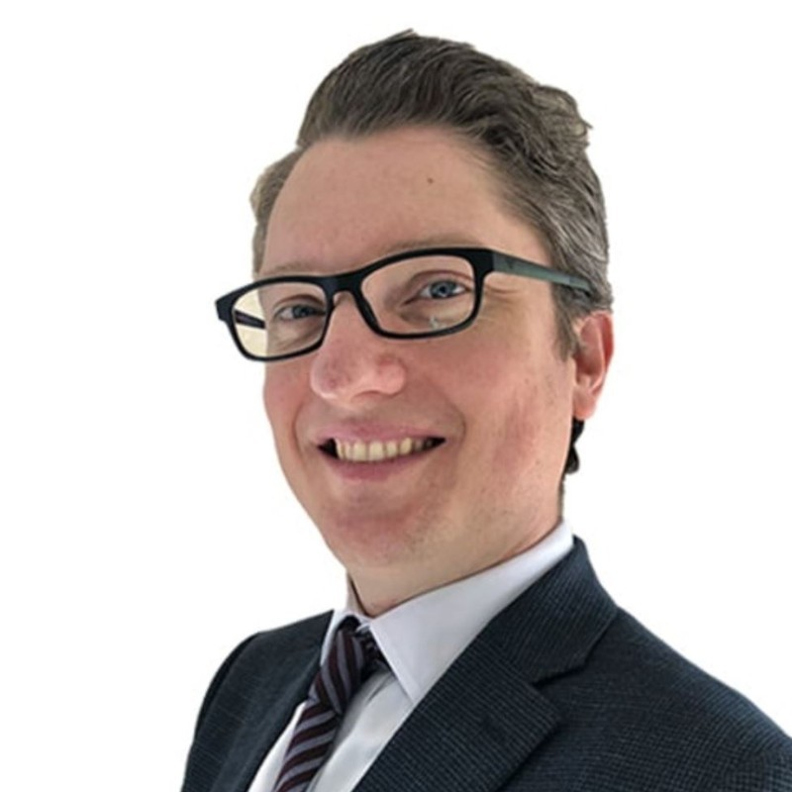
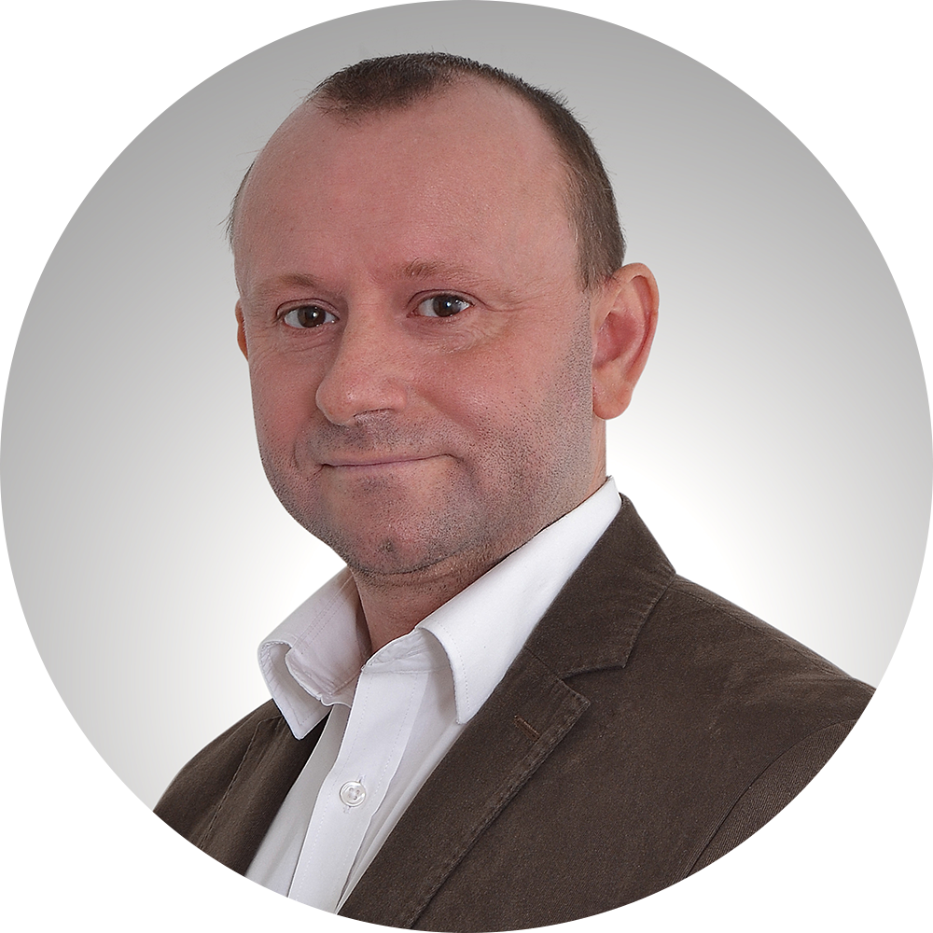
Meet our experts
CHRIS SOFFE – Global Supervisory Board at Gleeds, Vice Chairman Gleeds Americas
Chris Soffe heads up Gleeds’ global dispute advisory offering. He is a Past President of the Chartered Institute of Building, a Fellow of the RICS, a Member of the CIArb and a national panelist of the American Arbitration Association. He has 50 years of diversified project and cost management experience in the U.S., Europe, Africa and the Caribbean. Chris worked for regional and international construction companies prior to specializing in professional construction consulting. From 1991 to 2019, Chris was President and CEO and had responsibility for the group’s Americas operations, forging growth and worldwide relationships with Gleeds’ global partners. He is a strong advocate of conciliatory and collaborative dispute solutions and settlement.
ALEX JOHNSON - Partner, Engineering and Construction at Freeths LLP
Alex advises clients on contract terms, issues arising during the project, and in relation to dispute management and avoidance. His CV includes one of the largest international arbitrations in the world, as well as a number of high profile projects and substantial disputes for clients including owners, EPC contractors and supply chain members.
CRAIG BEESON - Director, Disputes Advisory at Gleeds
Craig is a Fellow of the Chartered Institute of Arbitrators, holding a LLM in Construction Law and Arbitration. He has 20 years’ experience in commercial, project controls, project management and dispute advisory roles, encompassing projects spanning all major industry sectors within the UK, Eastern Europe, the Middle East, Africa and Asia.

Slide 7
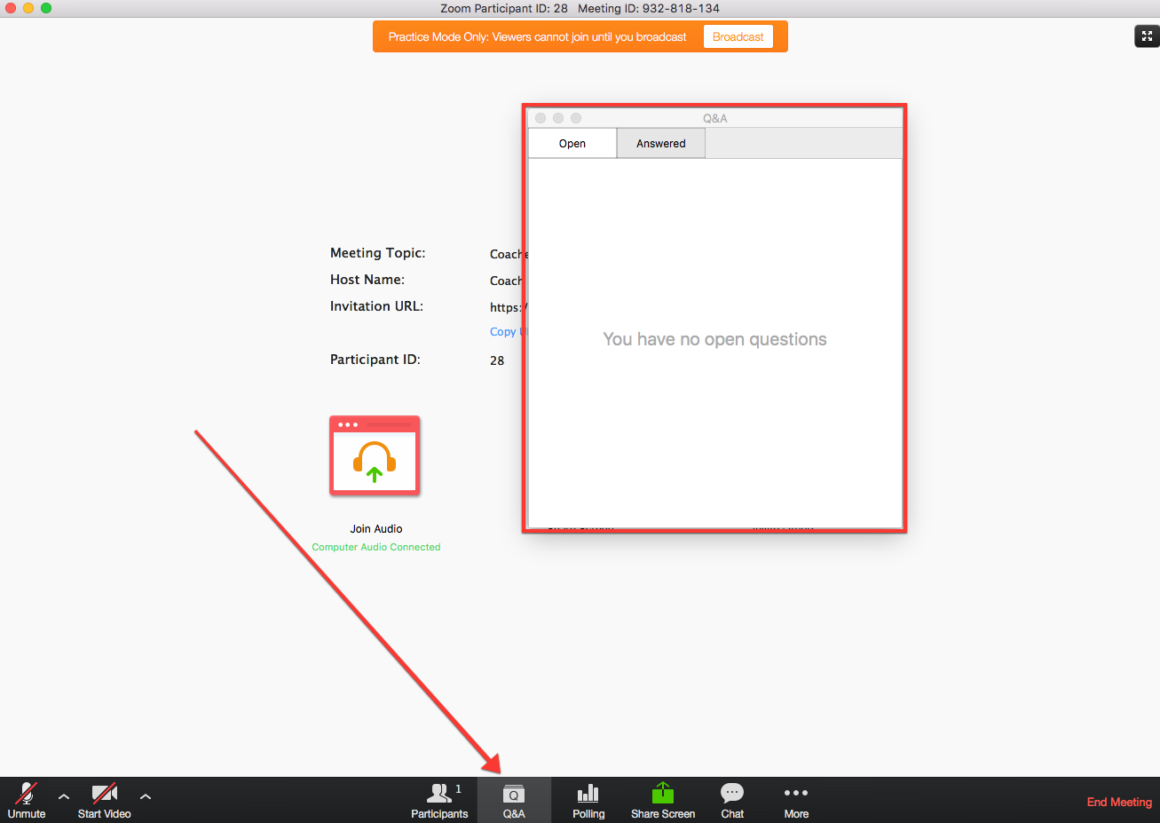

?
?
?
?
advisory@gleeds.qa
Notes:
Our goal is to strengthen existing and build new collaborative strategic alliances.
We’re counting on your support:
with introducing us to potential leads and/or identify DA opportunities
to reach out to us when you are facing issues with your current DA projects
if you want to get involved

Slide 8
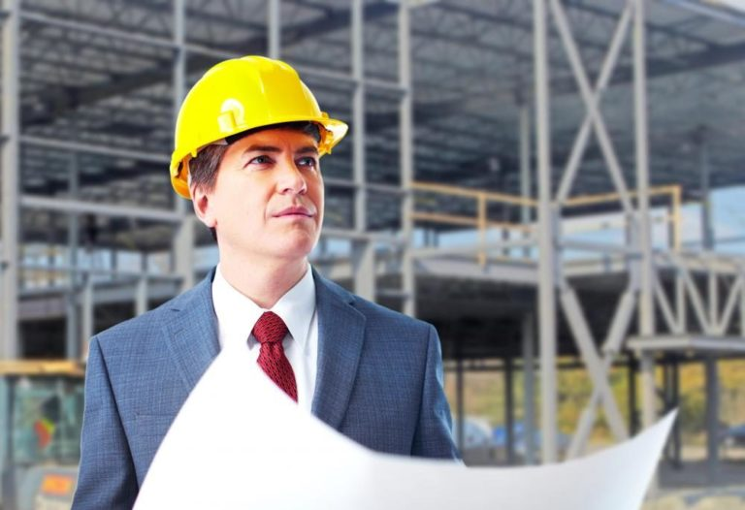


Your questions
HOW CONTRACTS DEAL WITH THE PANDEMIC?
Aligning with the
digital agenda
“What category of events does the pandemic fall under?”
  Specific event(s), if not:
    Prevention by Owner
    Change in law
    Force majeure

Slide 9







Your questions
HOW CONTRACTS DEAL WITH THE PANDEMIC?
“Can the impact of Covid-19 fall within Adjustments for Changes in Legislation as per Sub-Clause 13.7 under the FIDIC Yellow Book 1999?”
  Components:
    INCREASE OR DECREASE IN COST
    CHANGE IS TO LAWS OF THE COUNTRY
    NEW LAWS OR MODIFICATION/REPEAL OF EXISTING LAWS
    JUDICIAL OR GOVERNMENT INTERPRETATION OF LAWS
    AFFECT THE CONTRACTOR IN PERFORMANCE OF WORKS
    AFTER THE BASE DATE

Slide 10
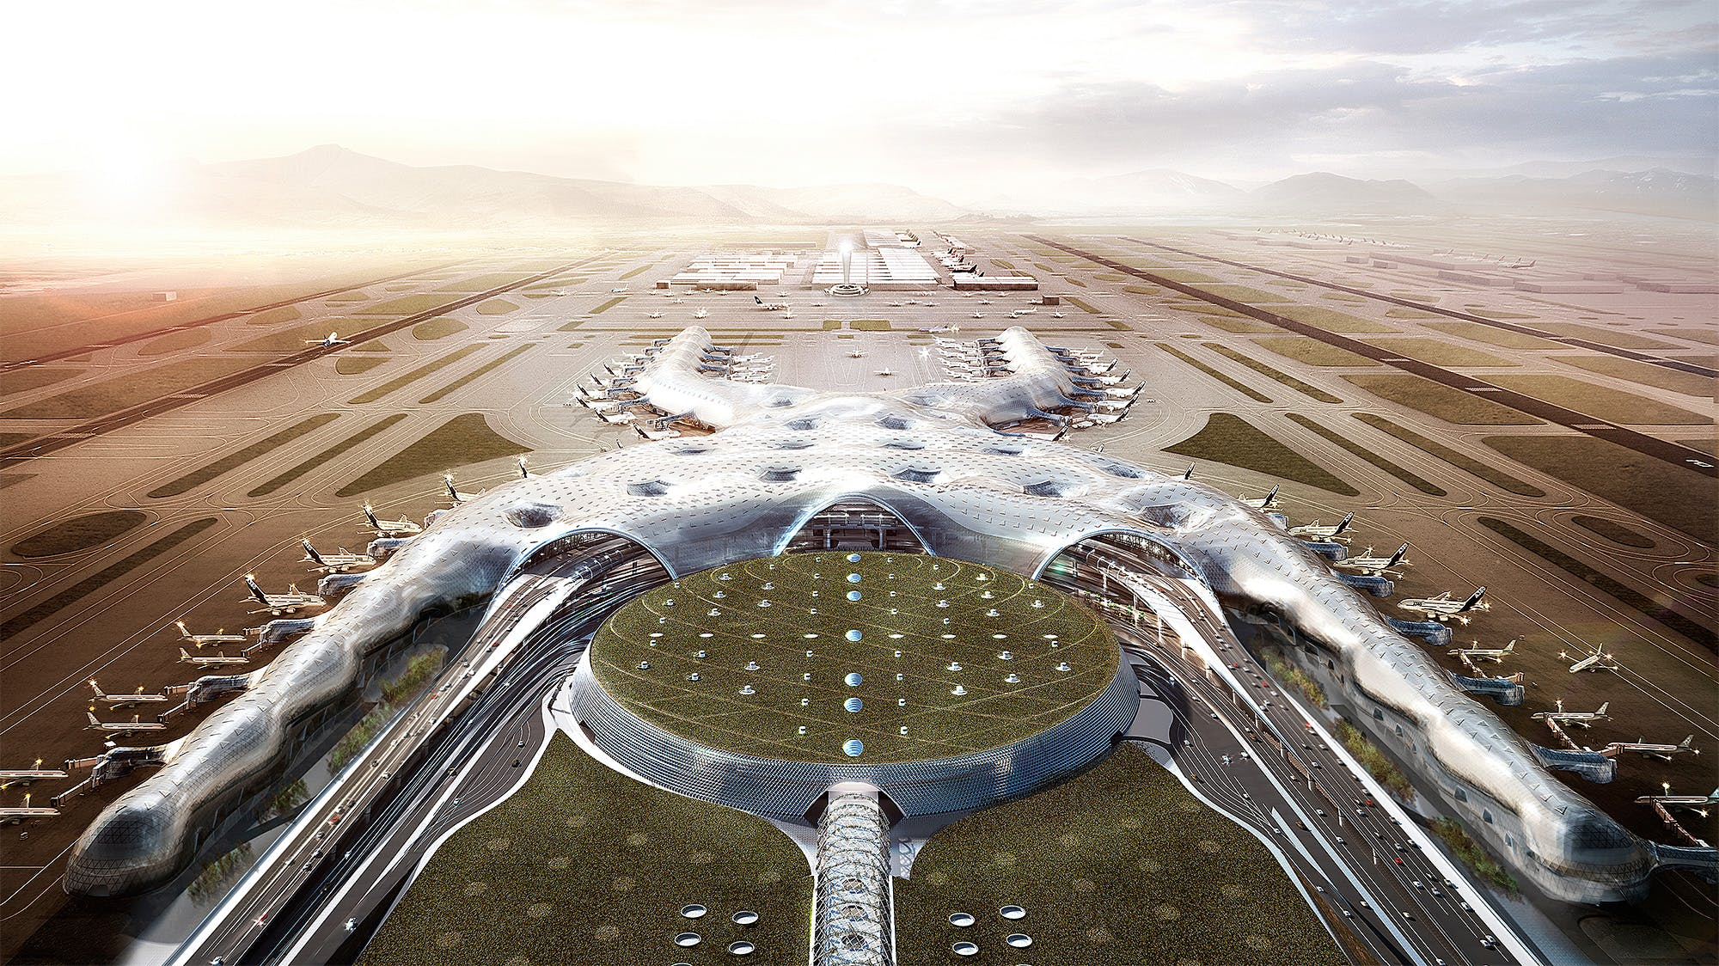
Your questions
HOW CONTRACTS DEAL WITH THE PANDEMIC?
“What exactly should we specify in the contract in order to avoid a claim for extension of time and/or additional payment related to the pandemic?”
  WHO BEARS
  THE RISK?
  USE A COVID
  CLAUSE
  PRIORITISE THE PROJECT

Slide 11
Your questions
RECORDS REQUIRED TO PROVE DISRUPTION
“Normally Owners are not exposed to loss of productivity risk. With the aftermath of COVID is there a need to capture this differently in new contracts and develop a system of record keeping of productivity?
QA/QC audits
Emails
Personal notes made in personal notebooks
Site diaries
Engineer or Project Manager (or client)
Records of formal or informal inspections of the site by an appointed
Witness testimony
Timesheets
Progress reports
Delivery notes
Site photos/videos
Resource allocation sheets
Minutes of meeting
Formal letters
Invoices from suppliers/subcontractors

Slide 12

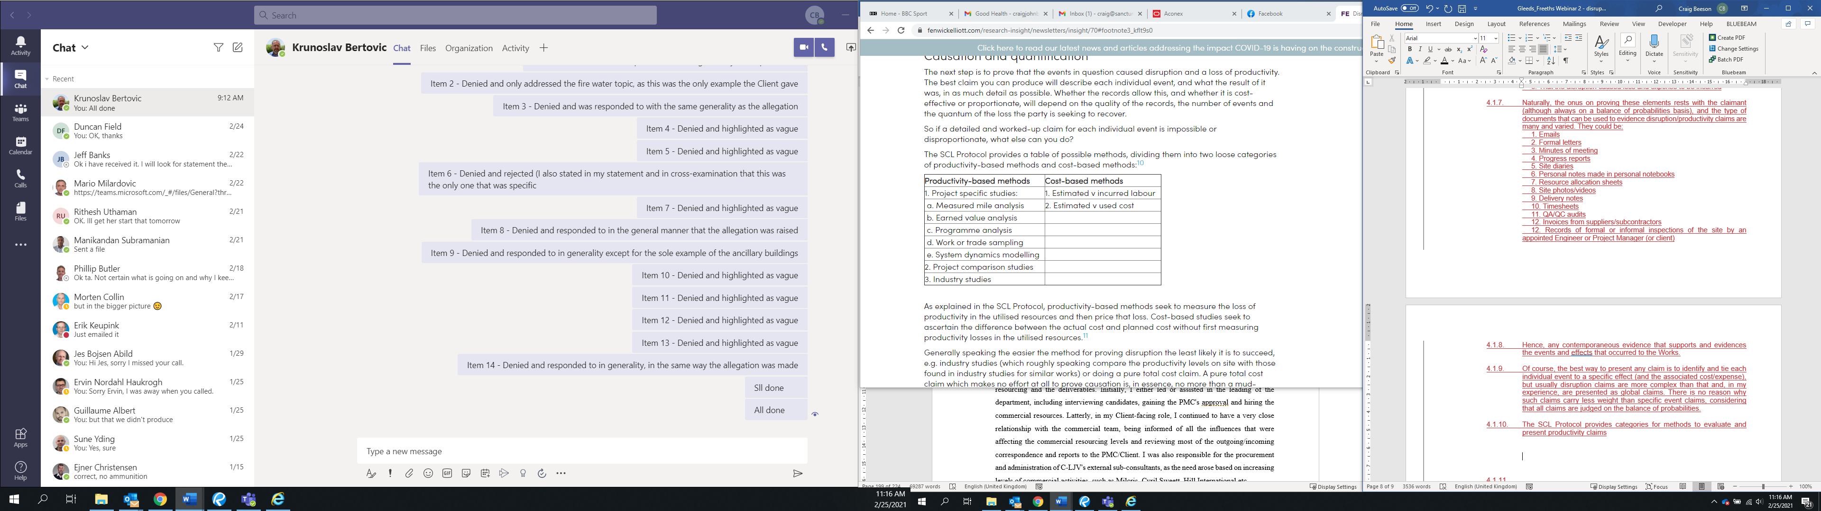
Your questions
RECORDS REQUIRED TO PROVE DISRUPTION
“How can we substantiate and show head office overheads in a claim for prolongation costs?”
THE HUDSON FORMULA | THE EMDEN FORMULA | THE EICHLEAY FORMULA
“How can the contractor claim or prove disruption due to inefficiency caused by the employer's events in the absence of baseline planned productivities?”

Slide 13
Recently received questions
How are the claims related to the pandemic be resolved/ remedied? Say, the contractor was unable to perform during the lockdown? When there are delay in the procurement/ delay of delivery of materials due to the flights/ border restrictions. Would these be considered under the force majeure clause, even if it’s not under the list of “exceptional events”? Or will it be under the unforeseeable circumstances? Or would it be considered under the clients risk and should be claimed under the warranty of contract?
How much Middle East Region does Gleeds have, as this is my main base of interest?
If the scarcity of resources(labour, plant etc) is caused by Pandemic, can a contractor claim such event under disruption claim?
If there is a Clause of Escalation of Base material in Contract such like is 10%+ or --.Means if rate will increase 10% above then client will pay or if reduce above 10% client will deduct. So my question is base rate should be consider without GST or with GST.I am certifying the same without GST.Is it Correct or Considering Calculation from base rate not after margin.
What is your take on social distance and the long term impact on productivity and cost for projects already procured.
What would be the top three focus areas of claims management to overcome the challenges of VUCA world?
Will be interesting to know how Covid impacts can be managed from a contractual point of view
Many Forms of Contract make it a condition precedent to issue timely notices and supporting documentation, however should Contractor not submit its notice or supporting information within the time frames required they seldom lose their rights, so why do these onerous clauses remain in Contracts

Slide 14
Recently received questions

Slide 15
advisory@gleeds.qa

